Slide 1
A Quick representation of Data Analysis

Slide 2
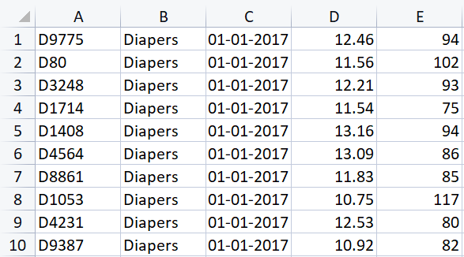
Given Dataset
Here in the dataset productid , Category, date, daily average price and demand are the attributes of data.

Slide 3
Working Methodology
First, i have imported all the required libraries for exploratory data analysis. Then after loading given dataset in my programme labeling is carried out.Then categorywise data is stored in three different variables. Then i have initialized required lists for making graphs. Then i have performed the most significant operation using for loop.I have calculated monthly average of price data , demand measure and revenue data for each particular caterogy.In the given dataset there was only two important attributes "price" and "demand".So, i have added one extra atribute named revenue measure which is calculated by multiplying average price and demand measure , so that is the measure regarding to daily revenue generated for all entries.And it clearly indicates measure of profit ultimately.

Slide 4
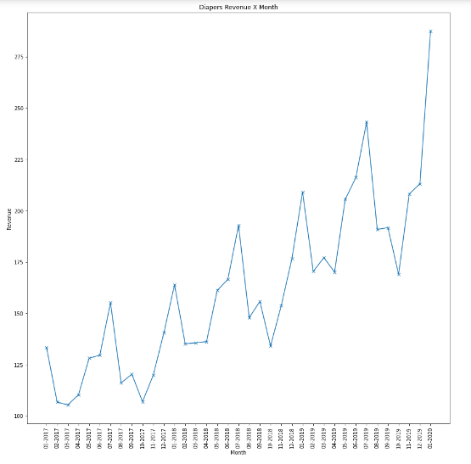
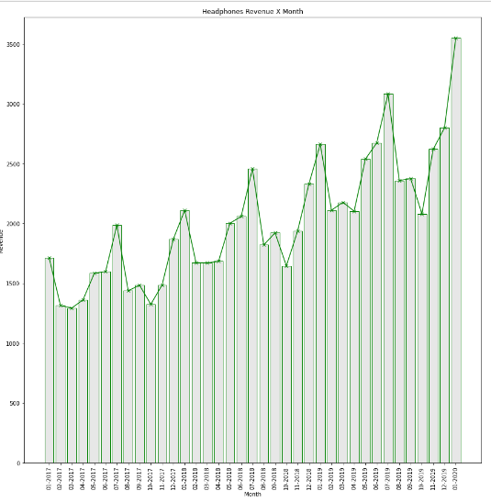
Revnue Vs Month analysis

Slide 5
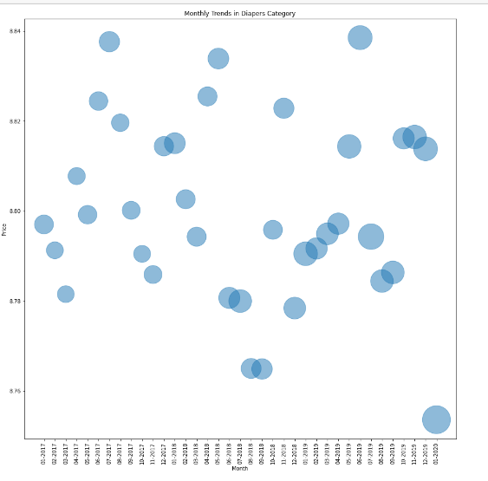
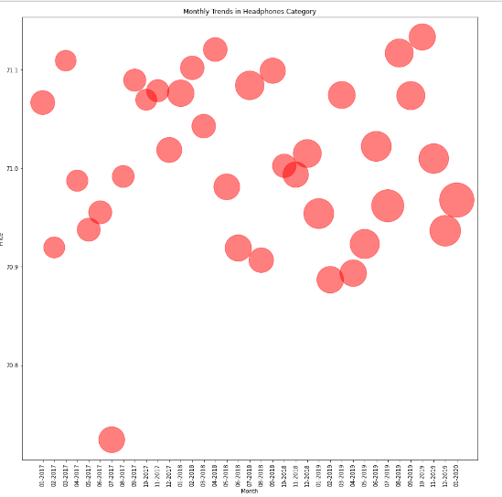
Monthly trends of price & demand

Slide 6
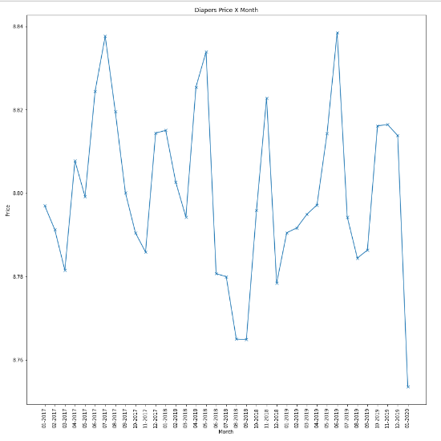
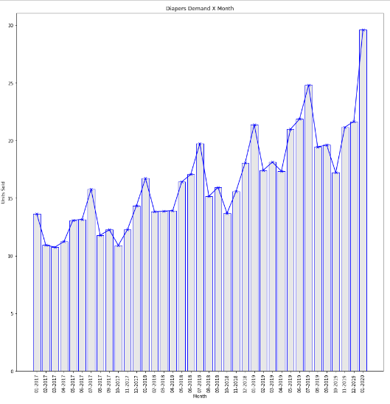
Price fluctuations with months

Slide 7
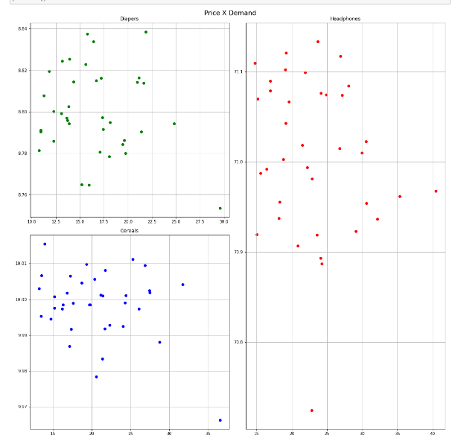
Price Vs Demand analysis category-wise

Slide 8
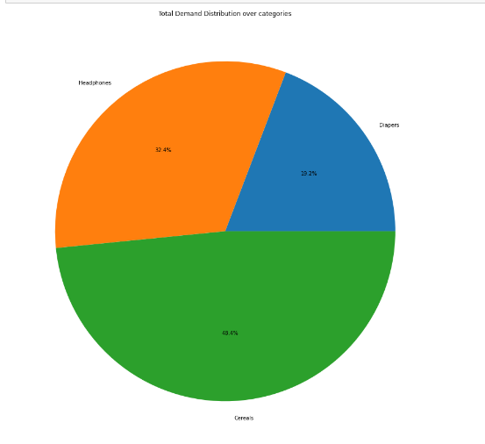
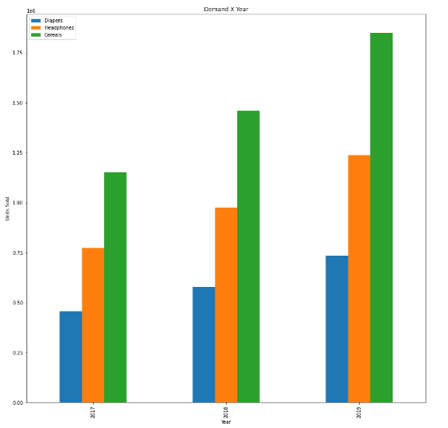
Demand analysis category-wise

Slide 9
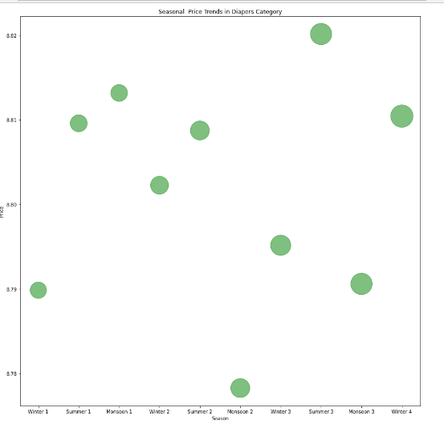
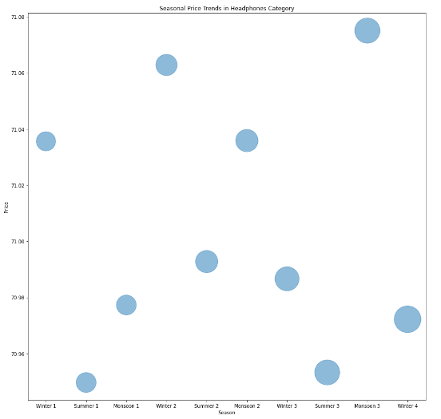
Seasonal price analysis

Slide 10
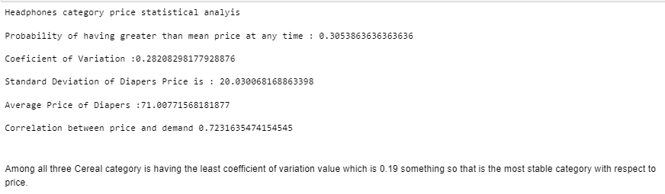
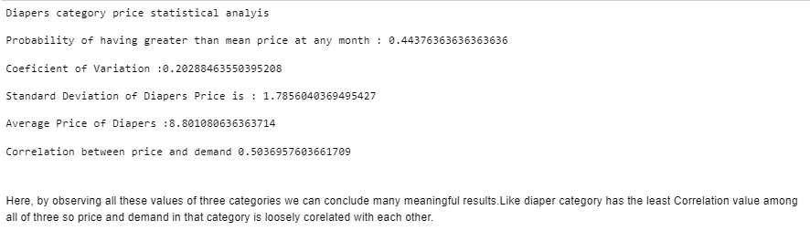
Statistical Analysis

Slide 11
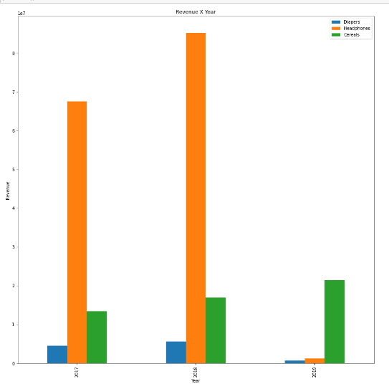
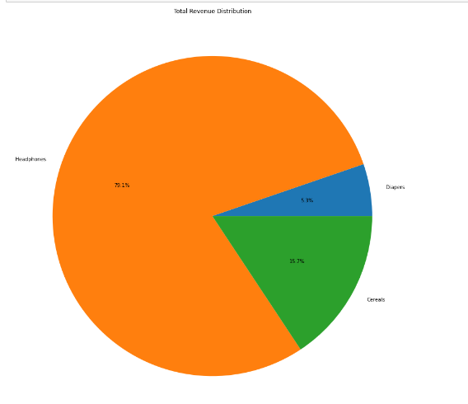
Revenue Analysis

Slide 12
Thank You

